Slide 1
Voltage/Current Reference
Prof. Jader A. De Lima

Slide 2
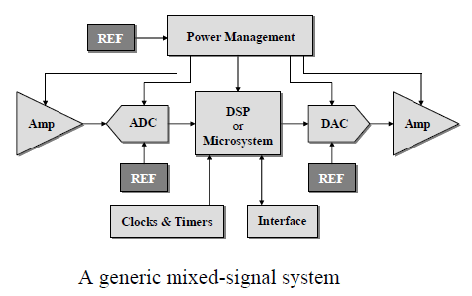

Slide 3
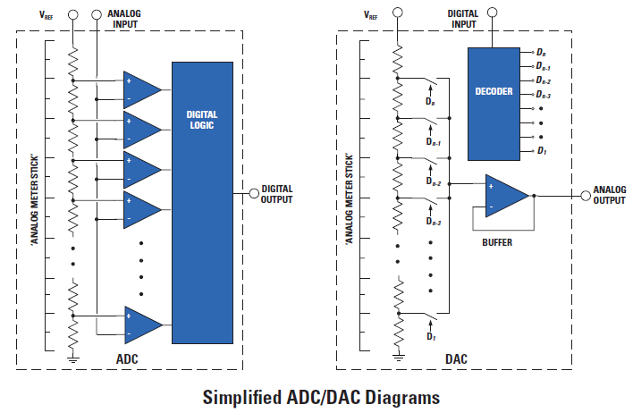
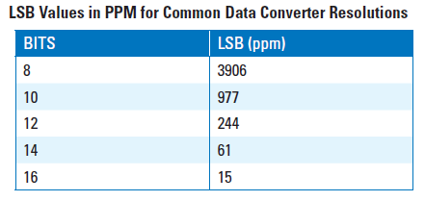
a voltage reference is an esential part in ADC´s, DAC´s, linear regulators, etc

Slide 4
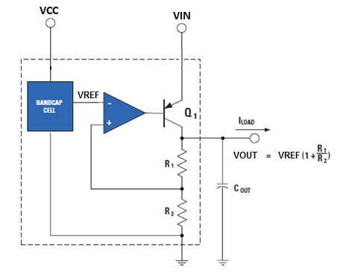
reference voltage for linear regulators (LDO´s)

Slide 5
series reference:
  provides load current through a pass transistor between
  VIN and VREF
  requires less power, as load current is provided as it´s needed
shunt reference:
  regulates VREF by shunting excess current to ground via a
  parallel transistor
  bias current must be equal or greater than load current

Slide 6
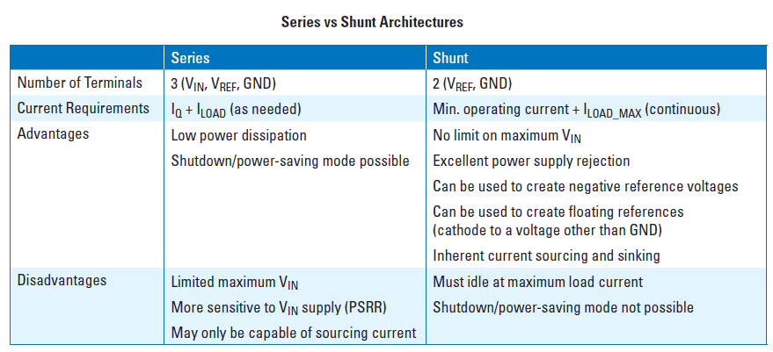

Slide 7

temperature coefficient (TC or tempco)
First-order (linear) TC
curvature of the voltage drift

Slide 8
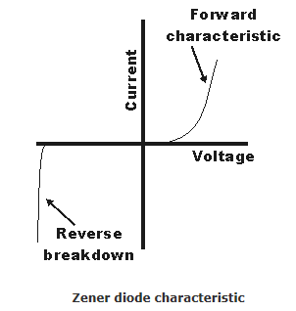
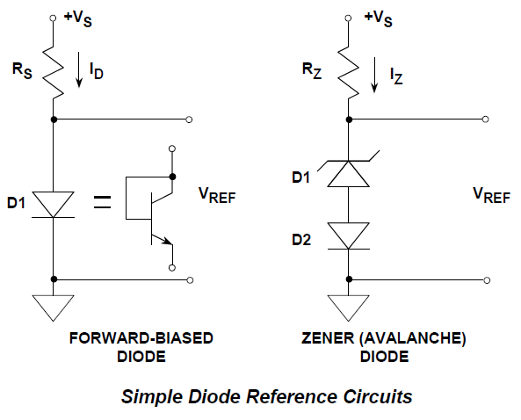
Voltage Reference
simple circuits
TC
+ 100ppm/ºC
Best TC @ high voltages
e.g. 6.2V!!
strong TC
-0.3%/ºC
TC > 0
TC < 0
avalanche is a rather noisy mechanism
Zener reference: best TC @ high voltages e.g. 6.2V
→ high supply voltage is required to achieve low TC from Zener reference

Slide 9
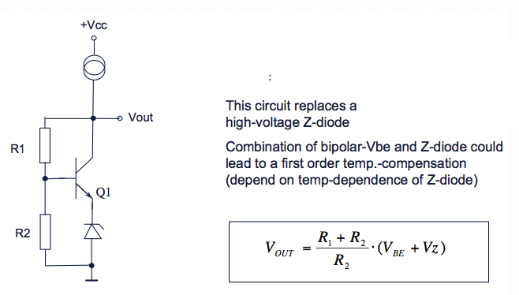

Slide 10
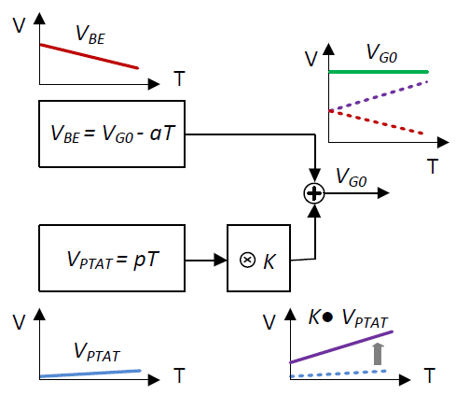
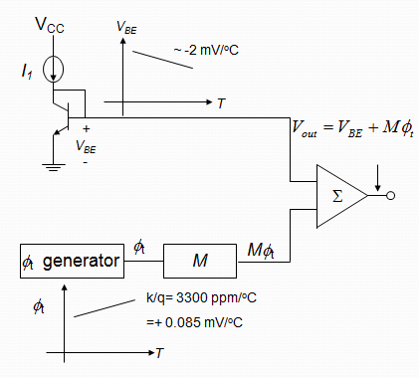
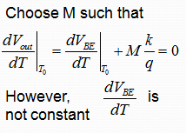
the bandgap reference concept:
CTAT
PTAT
output voltage for zero TC is close to bandgap voltage of Si (~1.2V)
V_{CC} must be higher than 1.2V → not suitable for sub-1V applications
R. J. Widlar, “New developments in IC voltage regulators,” IEEE J. Solid-State Circuits, vol. SC-6, pp. 2–7, Feb. 1971.

Slide 11
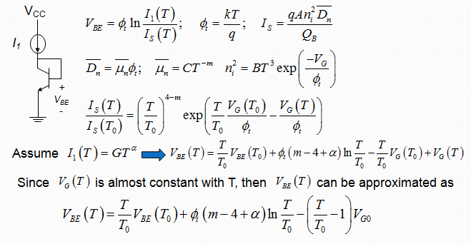
dependence of V_{BE} on temperature (CTAT voltage)

Slide 12
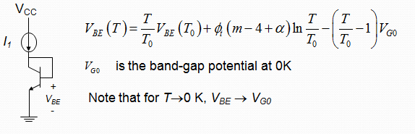

no laboratório (Exp 2)

Slide 13
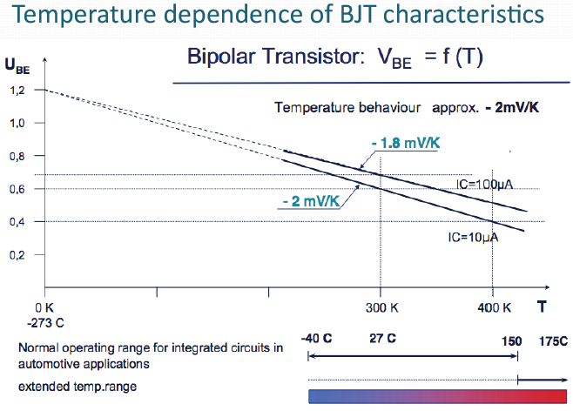

Slide 14
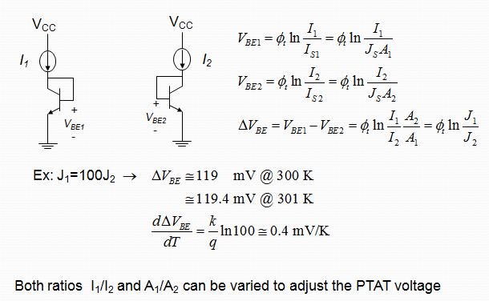
PTAT voltage

Slide 15
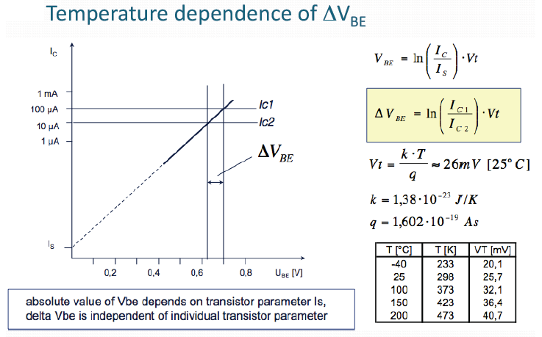

Slide 16
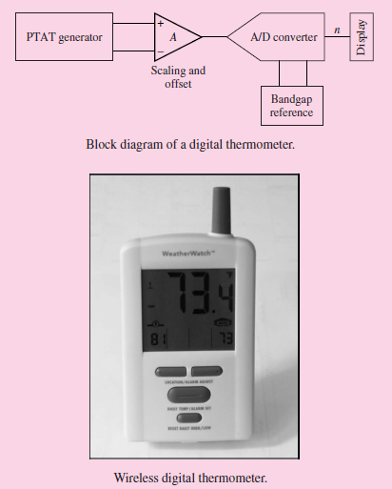

Slide 17
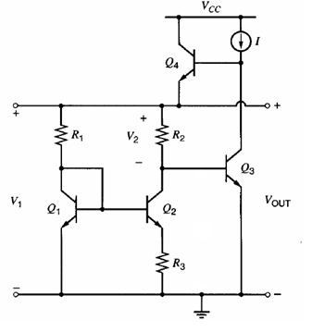


Determinar a referência Vout

Slide 18
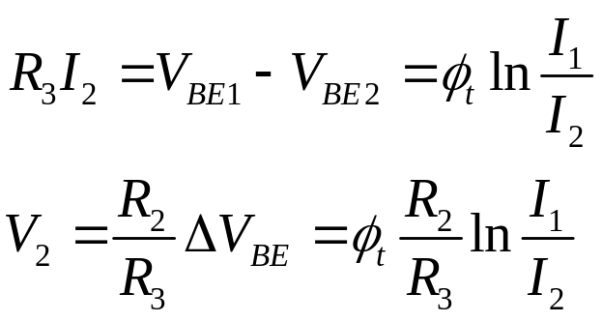
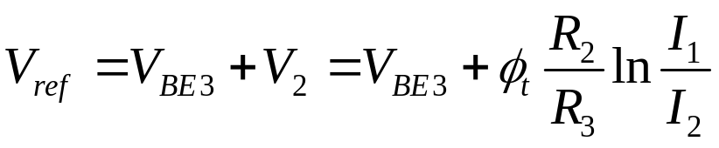
problem: maintain I₁/I₂ independent of T

Slide 19
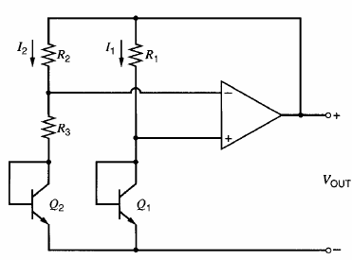

bandgap reference with an opamp
Since I1 = I2 (assuming R1 = R2)

Slide 20
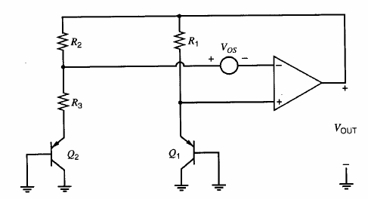





Slide 21
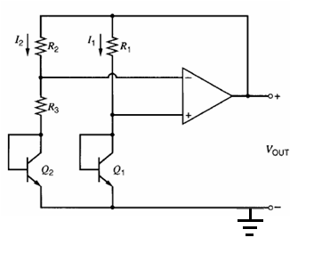

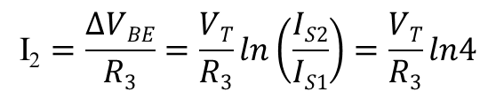
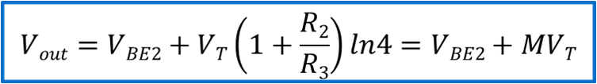

Ex: design the bandgap circuit for minimum variation @ T = 300ºK, assuming:
R1 = R2
IS1= 0.1pA
IS2 = 0.4pA
I1 = I2 = 1mA
β >> 1
∂V_{BE}/∂T = -2mV/ºK

Slide 22


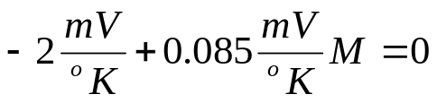

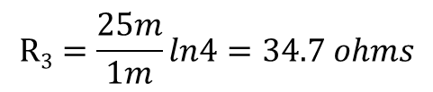
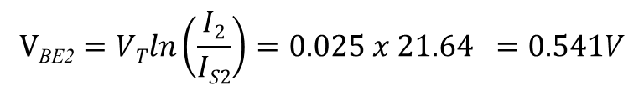

para T = T₀
R1 = R2 = 555.2 Ohms
para T₀ = 300ºK

Slide 23
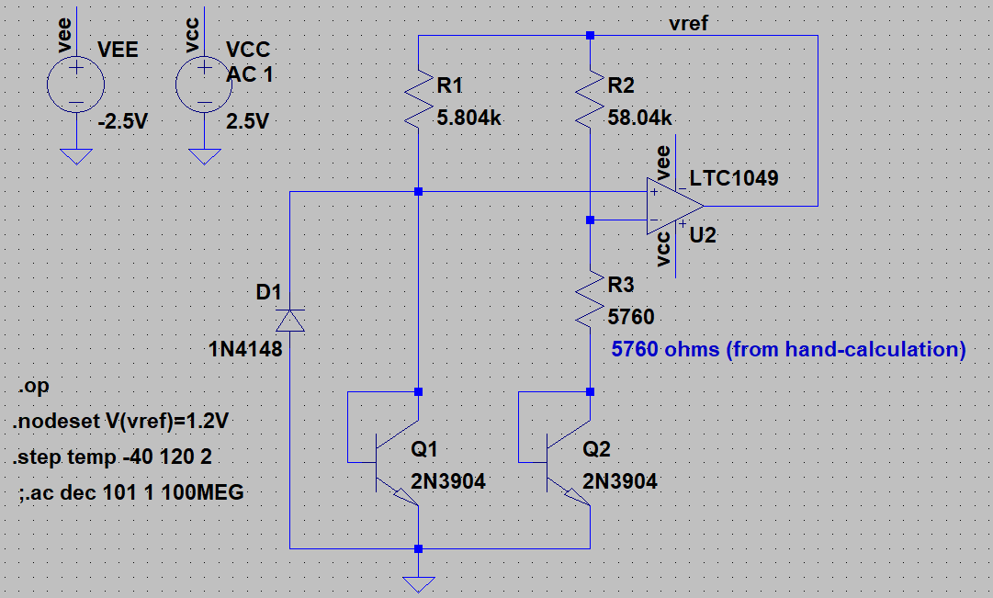
Ex: Q1 e Q2 casados e R2 = 10 R1

Slide 24
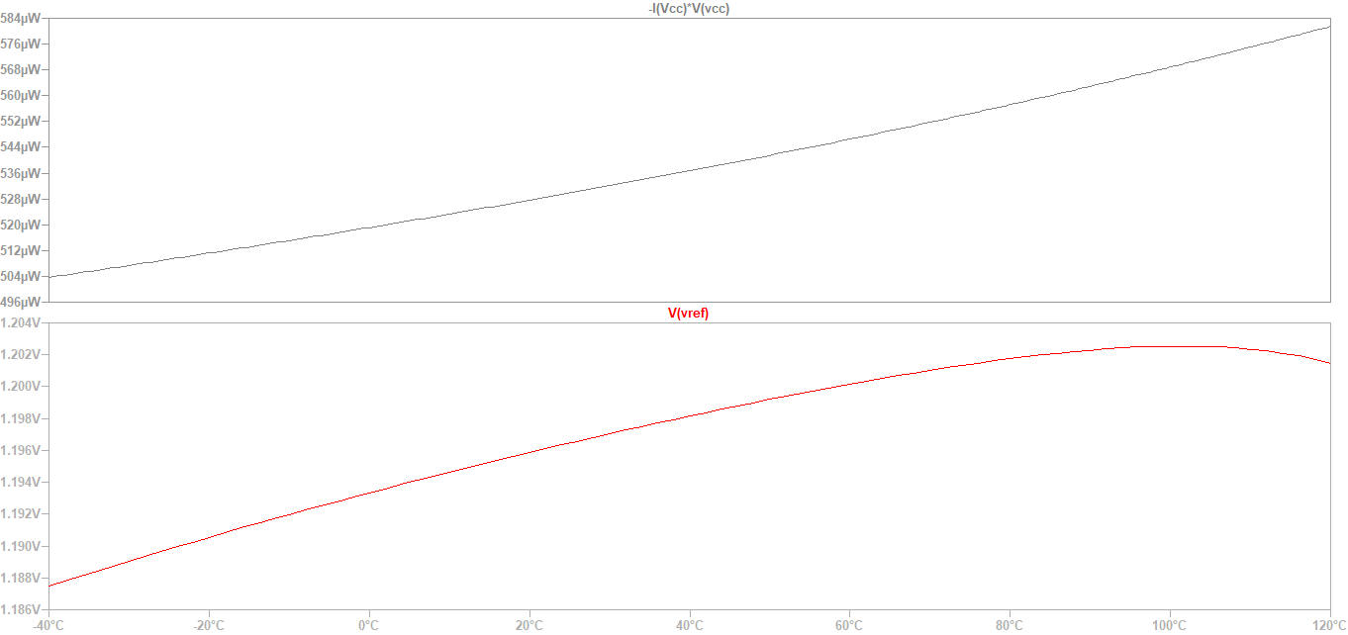
78.5ppm/oC
VREF = 1.196V @ 20oC

Slide 25
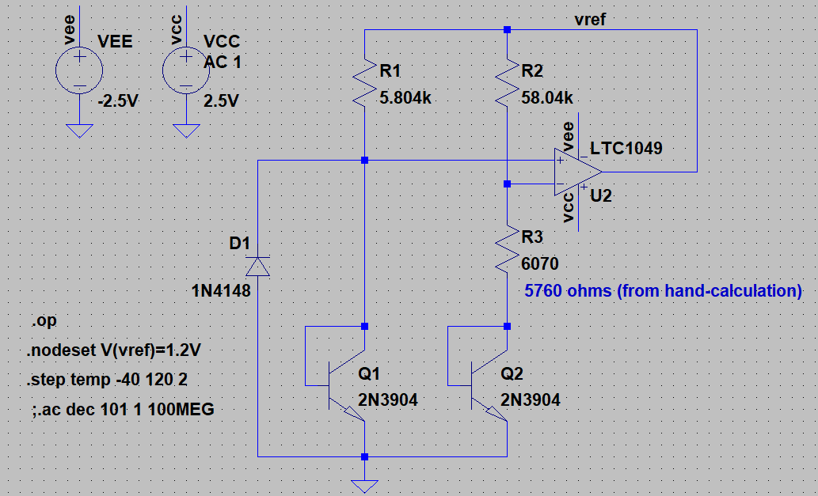

Slide 26
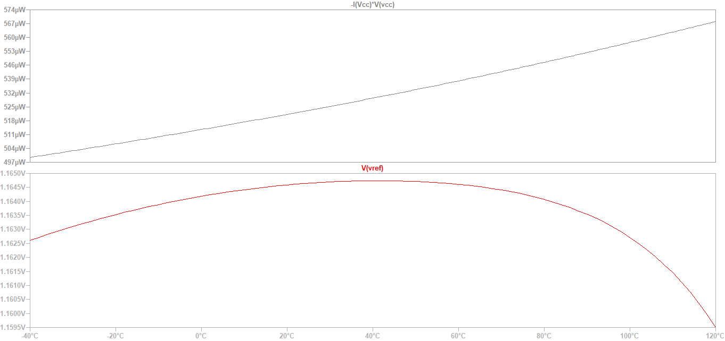
17.4 ppm/oC
VREF = 1.164V @ 20oC

Slide 27
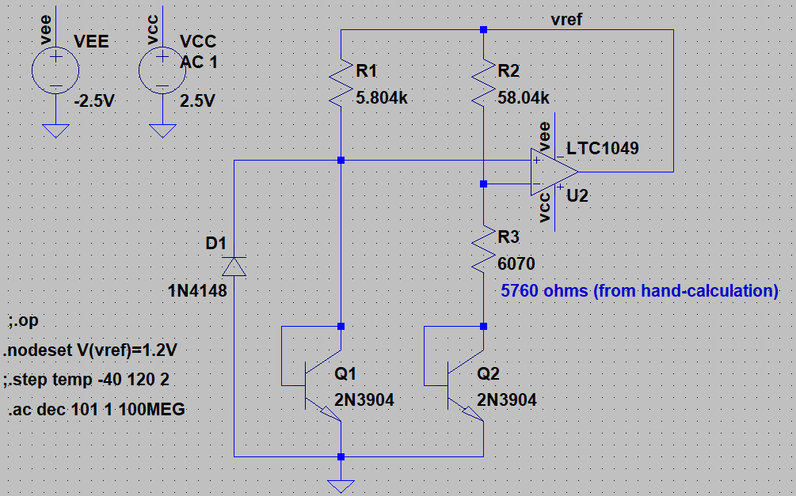

Slide 28
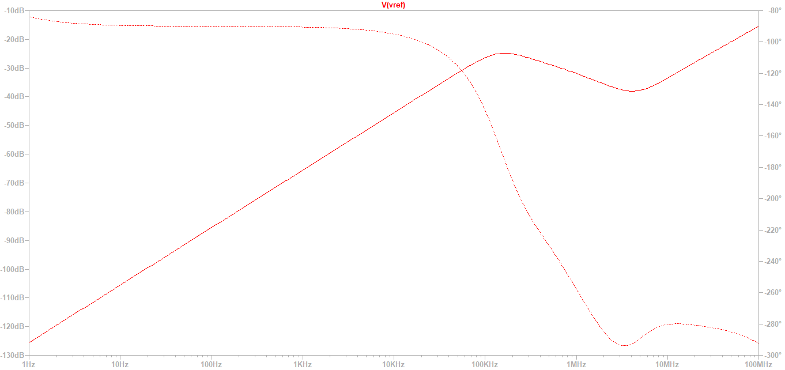
Poor PSR (Power-Supply Rejection) @ 100KHz and above

Slide 29
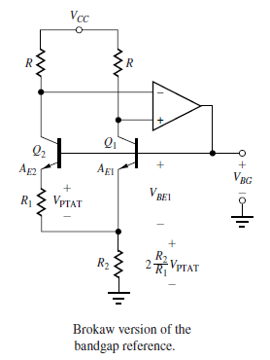
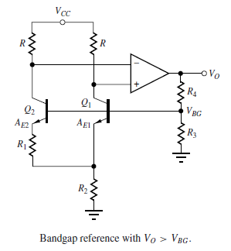




Slide 30
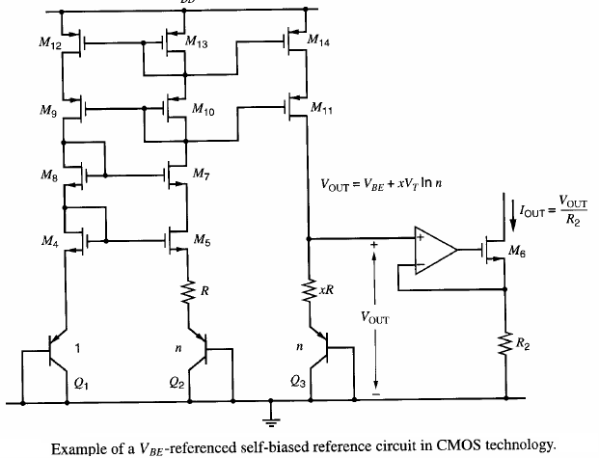
current mirror

Slide 31
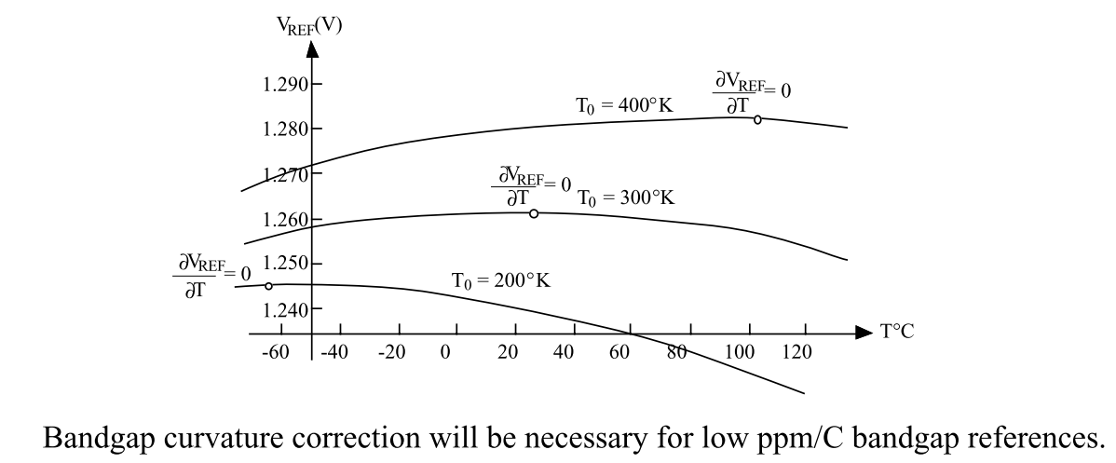

Slide 32
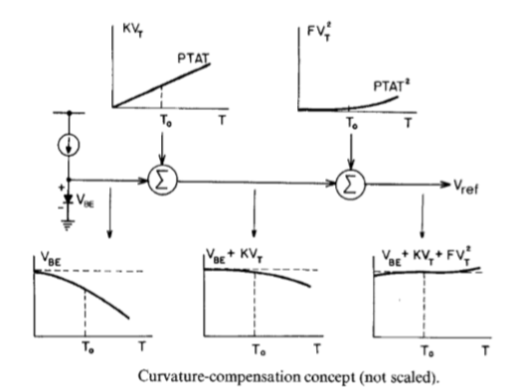

Slide 33
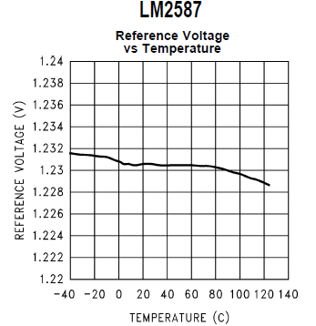

Slide 34
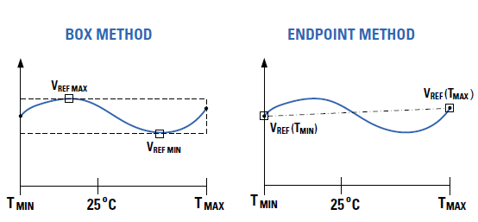
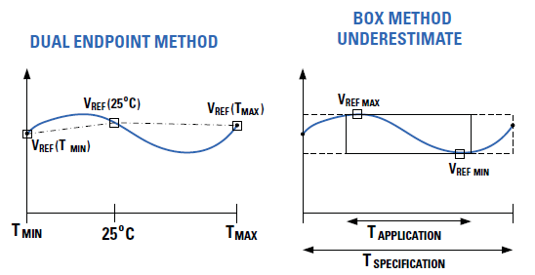

Slide 35
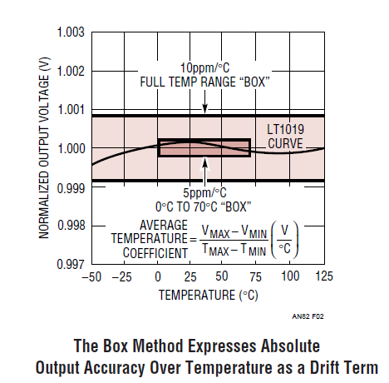

Slide 36
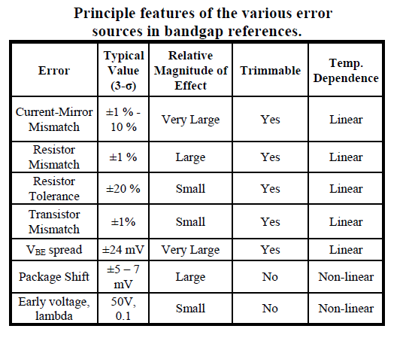

Slide 37
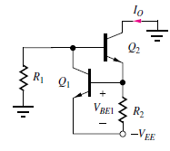
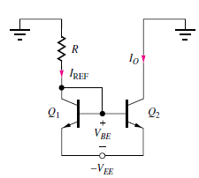




Reference Current Generation
β >> 1
supply dependent!

Slide 38
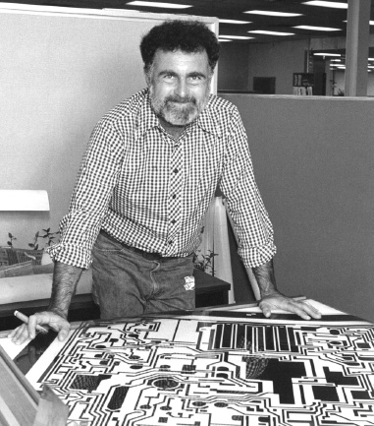
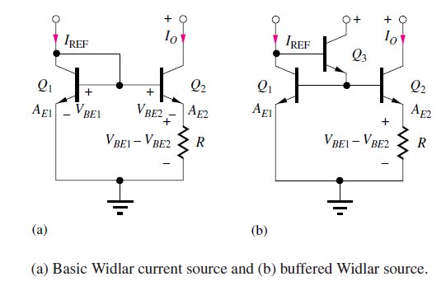




Widlar current source
Robert J. Widlar

Slide 39

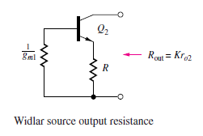

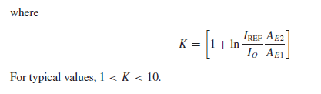

Slide 40




Slide 41
REFERÊNCIAS:
• Fundamentals of Microelectronics, B. Razavi, John Wiley and Sons, 2006
• Microelectronic Circuits, A. Sedra and K. Smith, Oxford university Press, 5th Edition, 2003

